Slide 1
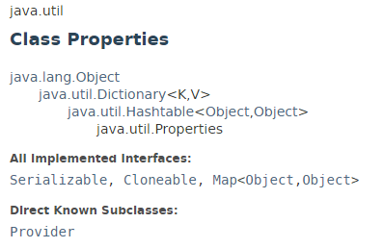
Properties Class
Properties are configuration values managed as key/value pairs. In each pair, the key and value are both String values. Using key we can retrieve the corresponding value.
Properties class provides methods for the following:
loading key/value pairs into a Properties object from a stream,
retrieving a value from its key,
listing the keys and their values,
enumerating over the keys, and
saving the properties to a stream.
Properties extends java.util.Hashtable. Some of the methods inherited from Hashtable support the following actions:
testing to see if a particular key or value is in the Properties object,
getting the current number of key/value pairs,
removing a key and its value,
adding a key/value pair to the Properties list,
enumerating over the values or the keys,
retrieving a value by its key, and
finding out if the Properties object is empty.

Slide 2
Properties Class
https://docs.oracle.com/javase/8/docs/api/index.html?java/util/Properties.html

